Slide 1


IMS Engineering College
(Affiliated to Dr. A.P.J. Abdul Kalam Technical University, Lucknow, India)
Department of Computer Science
Text Summarizer
Submitted To:-
HOD: Dr. Sonia Juneja
Mentor: Ms. Dhanshri Parihar
Submitted By:-
Abhimanyu Sharma
Ashutosh
Avinash Chaurasiya
Kuldeep Saini

Slide 2

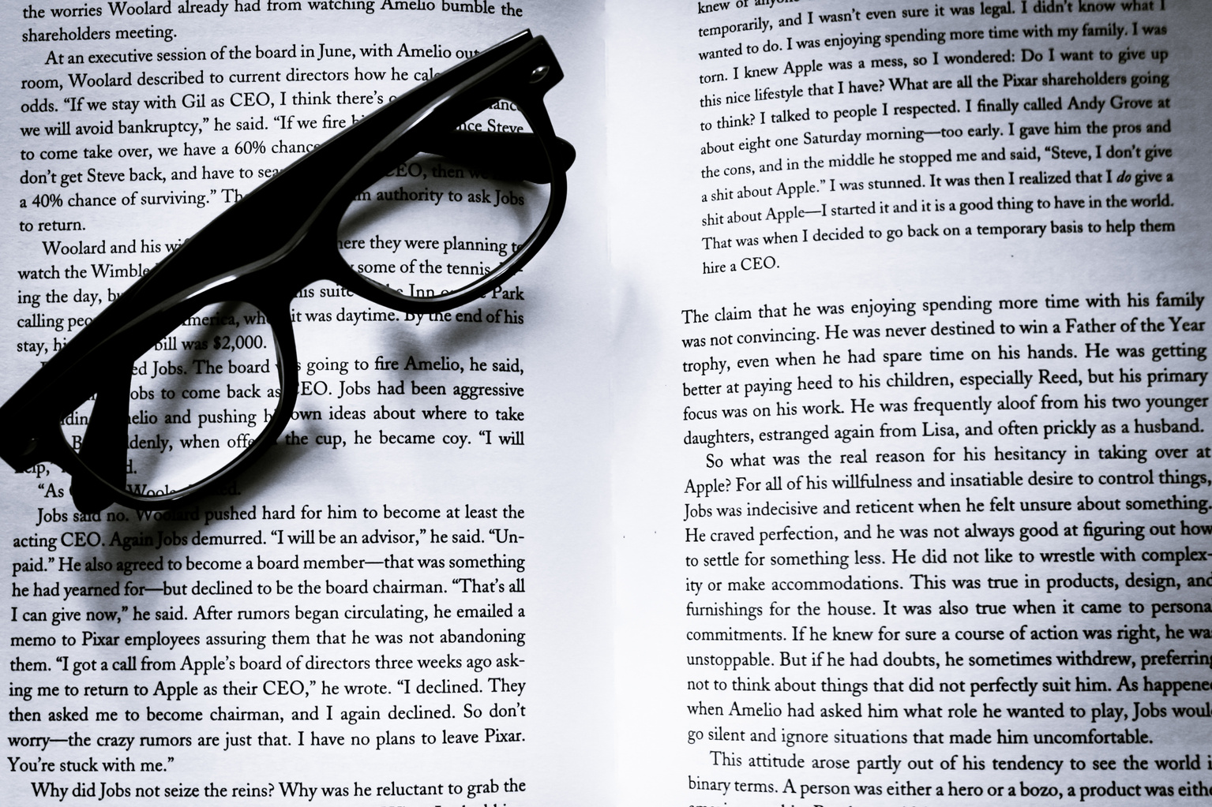

Text Summarizer
This project will be a web application where you can get extract-based summaries of drastically lengthy text. Text can be extracted from images or directly typed. It also allows conversion summaries to different languages.

Slide 3
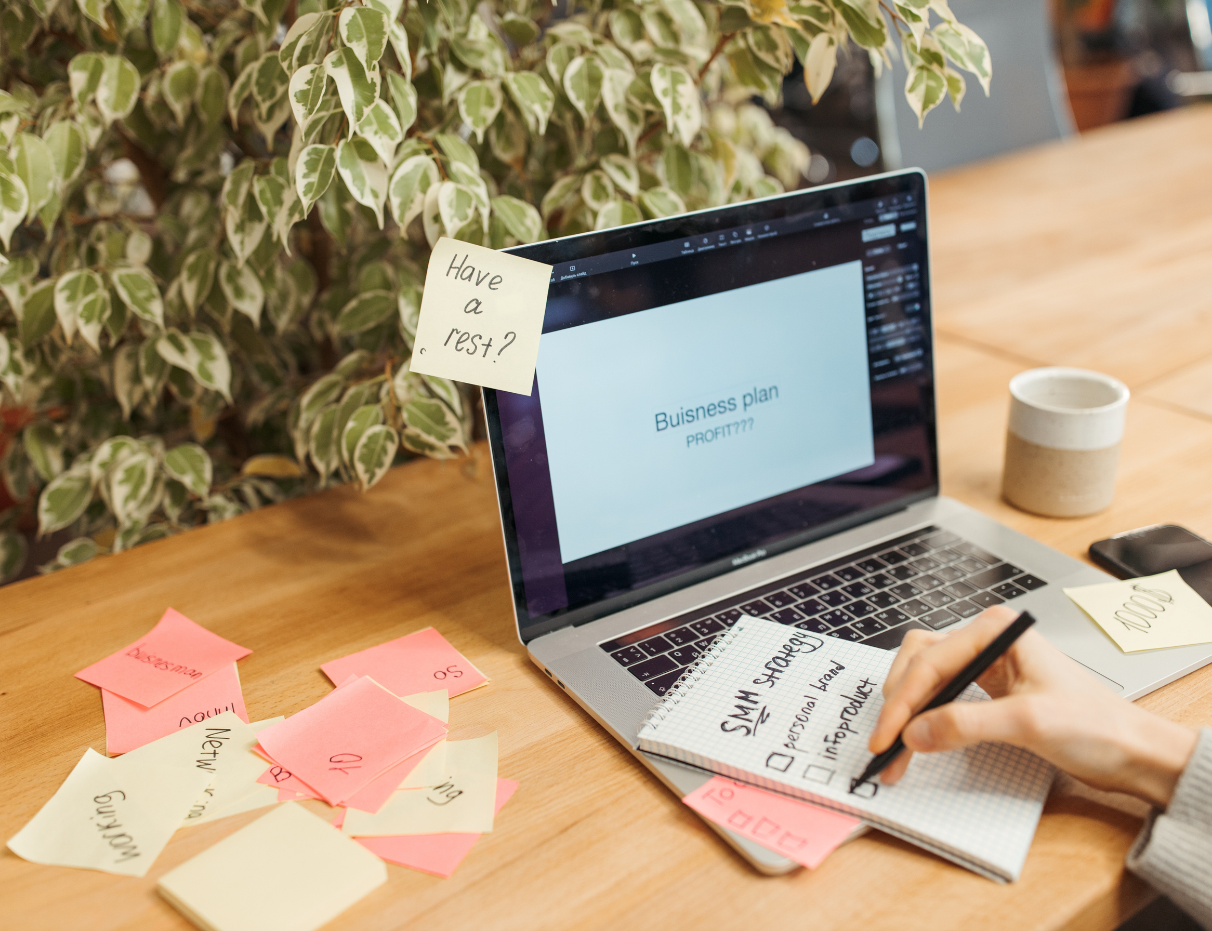
Content
Brief of Project
Methodology
Tools
Conclusion

Slide 4
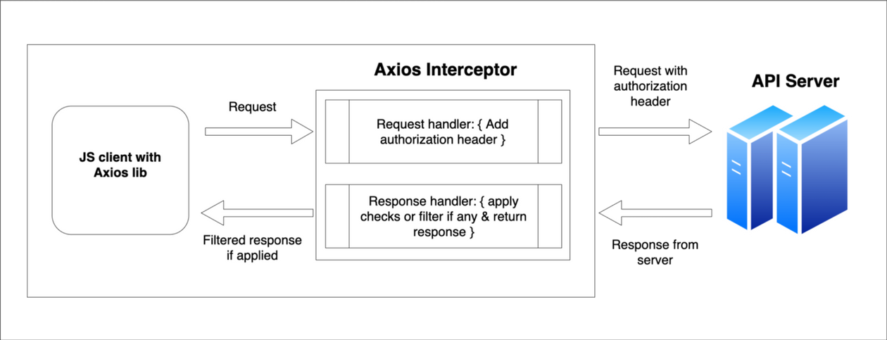
IMPLEMENTATION
Main UI - Website
Developed using React
Using Material UI which offers comprehensive suite of UI tools which help you ship new features faster.
Using useState() hook for dynamically updating and manipulating data in DOM if there is change in state.
Data send to the backend using axios
It is used to make XMLHttpRequests.
It can transforms request and response data

Slide 5
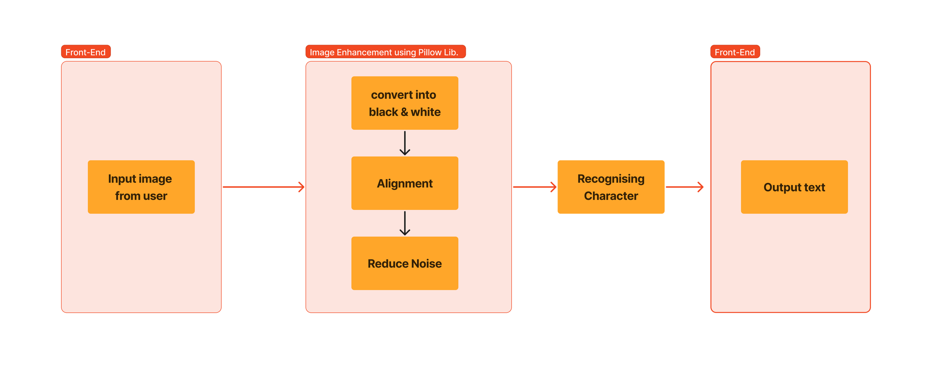
OCR Workflow
using javascripttessaract

Slide 6
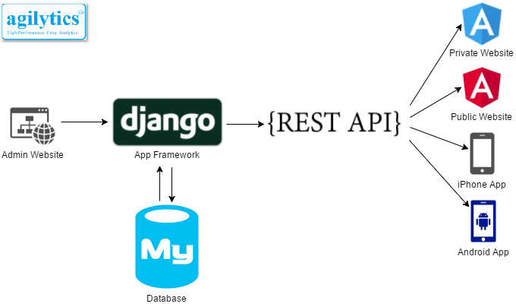
Backened and connnectivity
Backened server is developed using django
TFIDF Algorithm is implemented on django Server
Connection to backened is established using API
API is developed using Rest framework

Slide 7
Algorithm
TF-IDF (Term Frequency-Inverse Document Frequency
Main Steps:
Data preprocessing
Tokenization
POS( part-of-speech) tagger
stopwords removal
Stemming
Feature extraction
Tf = total appearance of the word
total words in the document
Idf=log( total doc/ no. of documents in which
term appears)
Summarisation

Slide 8




How Textus will possible
Technology we will use
For interface development we will use React js, which we will integrate with restfull django server.
OCR for text extraction from image.
Translation Ai for language conversion.
All development work will be done on Visual Studio code.

Slide 9
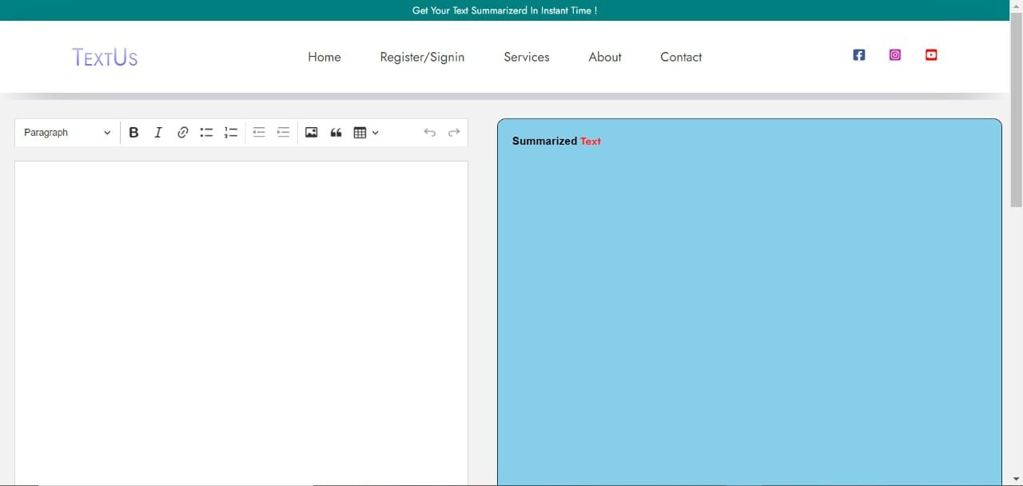
Front end UI

Slide 10
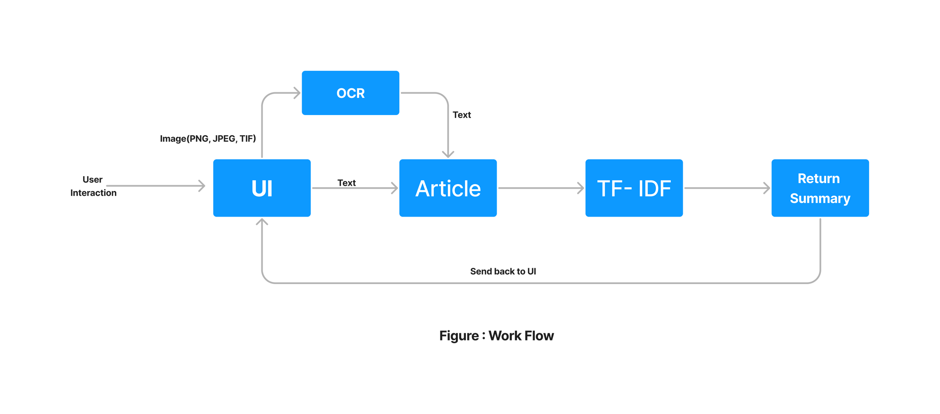
Work Flow

Slide 11
Thank You
Change is the only Constant

